Slide 1












Roey Fabian, Ron Sharabi, Amit Cohen, Eren Fishbein
Vox Populi Platform
Open-source framework
for data collection from
encrypted social networks
Supervisor: Dr. Nir Grinberg

Slide 2







Goal
To develop a platform that enables the collection of private information in
Hebrew from various platforms with
different communication protocols, and
make the platform accessible as open-source

Slide 3


!
Anonymization
The model is finished
& ready for testing
Project’s Status
System
The system received a maintenance update to enhance its recoverability.
UI
Web app went live,
connected to DB

Slide 4



Chat Processing
I
Regex
Anonymization
Dictabert Large NER
Entity Dictionary

Slide 5
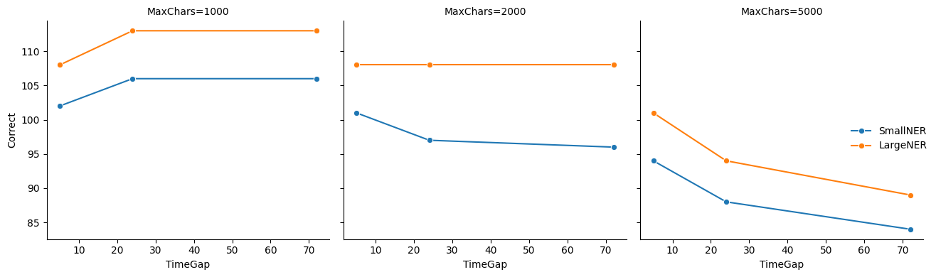
Phase 1 Summary

Slide 6


Dictionary Enhancements
(Name Detection)
Added each newly found name to a dynamic dictionary during processing
Performed a second pass using the full dictionary after the initial run.
Included Hebrew prefix variations like
"כש", "ל", "מ", "ו", etc.
Enforced word-boundary constraints
to avoid partial matches

Slide 7
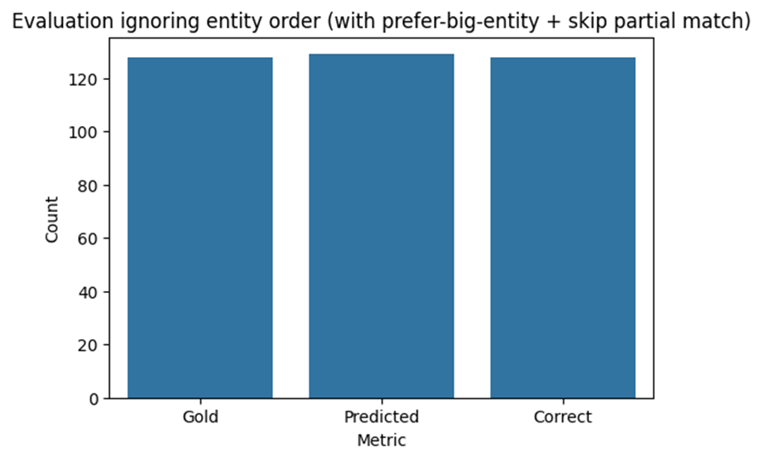
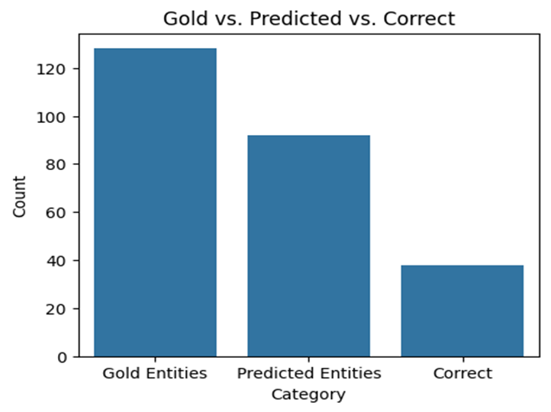
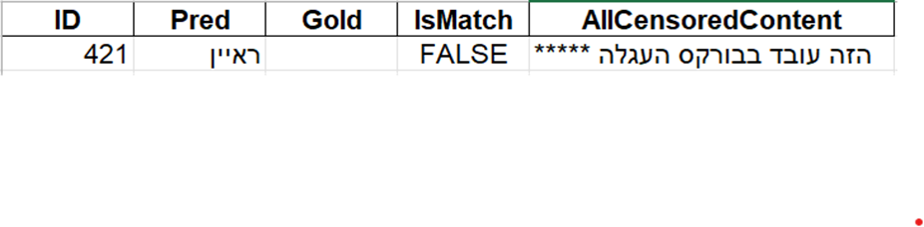
=== Evaluation Results ===
Total Gold Entities: 128
Total Predicted Entities: 129
Correct Matches: 128
Precision: 0.992
Recall: 1.000
F1 Score: 0.996

Slide 8
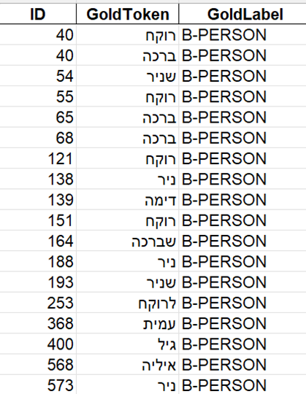
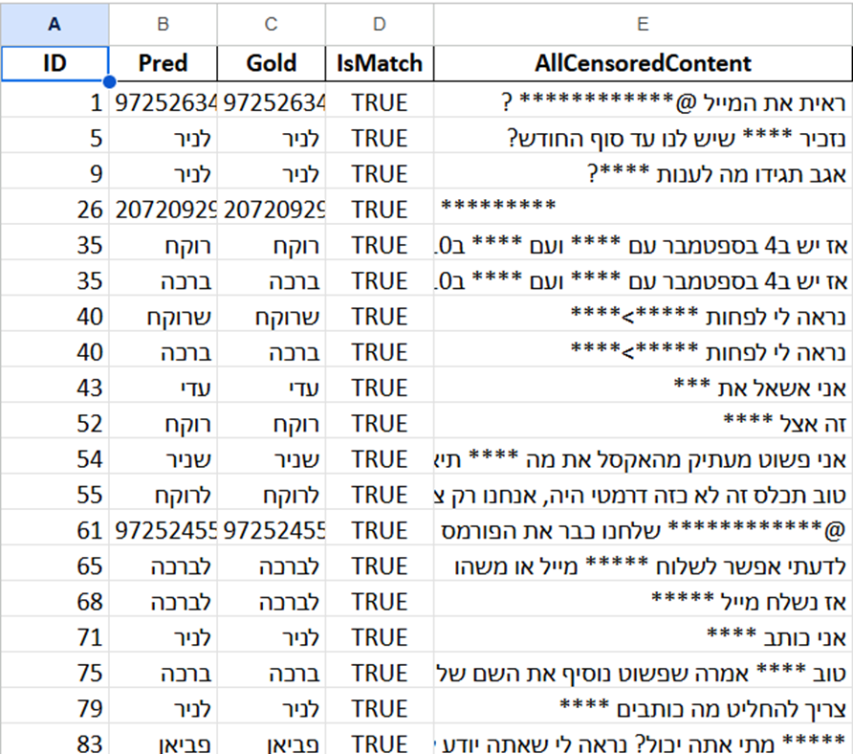
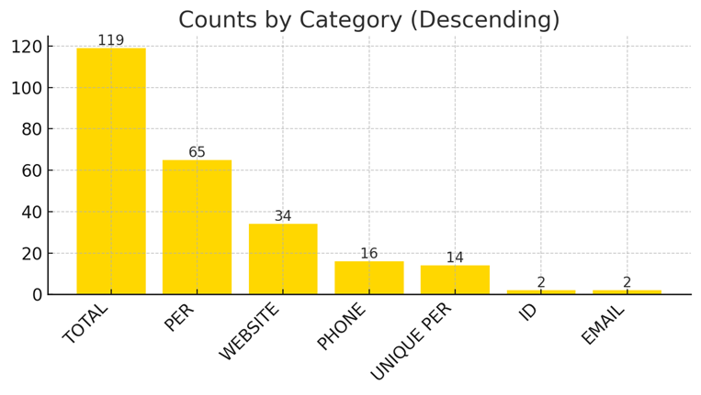
Missed Before
Example

Slide 9

Two New Group Chats:
BUILDING– currently under review and improvement
DOG WALKING – final control group for evaluation
Initial Findings – BUILDING Group:
50 out of 56 unique names successfully detected
differences between Base and Large models
Considering a combined model or dictionary approach
Future Work
Observed Challenges:
Ambiguity: "שלום" (greeting vs. name)
Missed: "משפחת הלר / דמרי" not recognized
Plan to enhance detection via custom regex patterns

Slide 10
Potential Improvements
Merge predictions from both models
or their dictionaries
Develop advanced regex for name structures
(e.g. "משפחת ___")
Consider fine-tuning the NER model on
chat-specific data
Potential Improvements & What’s Next
Next Steps:
Final pass of evaluation + corrections on
BUILDING group
Run full anonymization & evaluation on
DOG WALKING group
Red Teaming - synthetic chat for ‘attacking’ our model
Integration into the system

Slide 11
II
System

Slide 12


Feature | Implemented
Infrastructure as code(robustness)
Message reading client

Slide 13
What’s next?
Data exportation
Logging messages to the DB
Web App Integration

Slide 14
III
User Interface

Slide 15
Log In
Feature | Implemented
Role Selection
Login System
Platform Overview

Slide 16
User
Feature | Implemented
Chats + Chats Picker
Chat Start Date
QR Code
Deactivate account

Slide 17
Researcher
Feature | Implemented
User Management
Projects Overview
Project Creation
Chat Analysis
Data Exportation

Slide 18
TASK / PROCESS
24.4
4.5
8.5
9.5
22.5
1.6
15.6
20.6
26.6
Anonymization
FINE TUNING
System & DB
CHATS EXPORT
Web App
DATA INTEGRATION
DATA ANALYSIS
PROJECTS DAY
Platform
PILOT
TESTING
GOAL STRETCH
TESTING

Slide 19


thank you!

